Slide 1
PythonDS-08 String in Python
Dr. Naveen Kumar
Associate Professor
Amity Institute of Information Technology
Amity University Patna

Slide 2
String in python
In Python, str is a built-in immutable sequence data type used to store and manipulate textual data. It represents a sequence of Unicode characters, meaning it can natively store letters, numbers, symbols, and even emojis.
Standard Quotes (Single & Double)
These are the most common ways to create standard text strings. They behave identically.
Single-quoted strings: Enclosed in '...'. Useful if the text contains double quotes.
Double-quoted strings: Enclosed in "...". Useful if the text contains single quotes (like apostrophes).

Slide 3
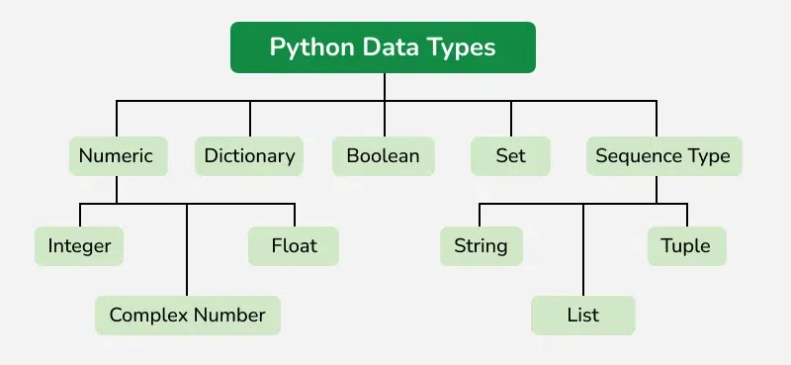

Slide 4
1. Creating Strings
Python provides several syntax options to define a string literal:
# Single or Double Quotes (Standard)
single_coords = 'Hello'
double_coords = "World"
# Triple Quotes (Multi-line strings, preserves formatting/newlines)
multiline = """This is a
multi-line string."""
# Raw Strings (Prevents backslash escaping; ideal for RegEx or file paths)
raw_path = r"C:\next\folder\file.txt"

Slide 5
Multiline Strings (Triple Quotes)
Enclosed in '''...''' or """...""". They allow text to span across multiple lines while preserving all line breaks and spaces automatically. They are also frequently used as "docstrings" for code documentation.
multiline = """This is line one.
This is line two."""

Slide 6
Special Prefix Strings
You can add a lowercase or uppercase letter right before the opening quote to give the string special properties: []
F-Strings (Formatted Strings) f"...": Evaluates variables or mathematical expressions directly inside curly braces {} at runtime. []
Raw Strings r"...": Treats backslashes \ as literal characters instead of escape characters. Essential for windows file paths or regular expressions (regex).
Byte Strings b"...": Creates a bytes object rather than a regular string (str). It represents raw 8-bit bytes and is heavily used in file handling, network sockets, and data streaming.

Slide 7
name = "Alice"
print(f"Hello, {name}") # Output: Hello, Alice
print(r"C:\Users\name\new") # Output: C:\Users\name\new (ignores \n newline)
print(b"Hello") # Output: b'Hello' (Type: <class 'bytes'>)

Slide 8
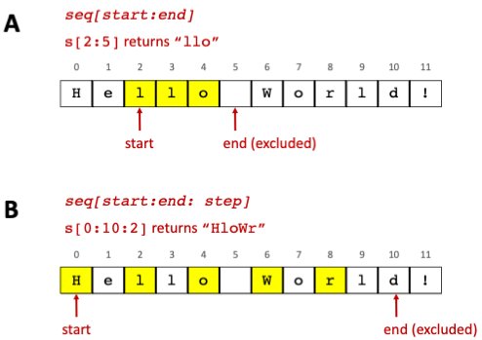

Slide 9
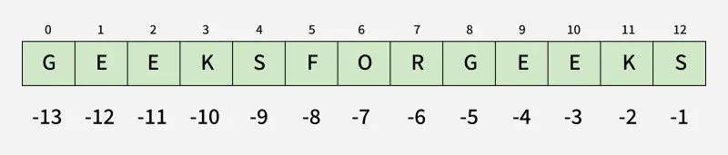
2. Core Concepts: Indexing and Slicing
Strings use zero-based indexing to access individual characters and supporting negative indices to access characters starting from the end. []
text = "Python"
# Indexing
print(text[0]) # Output: 'P'
print(text[-1]) # Output: 'n' (last character)
# Slicing syntax -> text[start:end:step]
print(text[0:2]) # Output: 'Py' (index 2 is excluded)
print(text[:4]) # Output: 'Pyth' (defaults start to 0)
print(text[::2]) # Output: 'Pto' (steps by 2 items)
print(text[::-1]) # Output: 'nohtyP' (reverses the string)

Slide 10
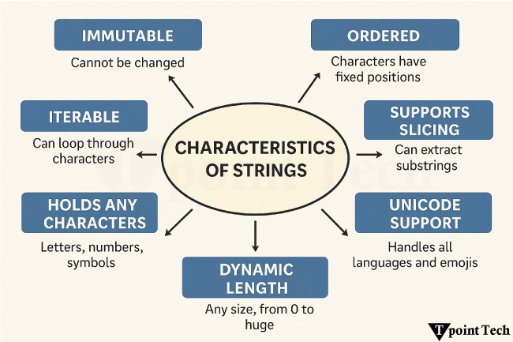

Slide 11
3. Structural Immutability
Strings are immutable, meaning their characters cannot be updated or altered in place once created. Any modification operation creates a completely new string object in memory.
msg = "Hello"
# msg[0] = "Y" --> Raises TypeError: 'str' object does not support item assignment
# Correct Approach: Reassign or construct a new string
msg = "Y" + msg[1:]
print(msg) # Output: "Yello"

Slide 12
4. Essential Built-in String Methods
Category | Method | Description | Code Example | Output
Case Changes | .upper() | Converts to uppercase | "py".upper() | "PY"
 | .lower() | Converts to lowercase | "PY".lower() | "py"
 | .capitalize() | Capitalizes the first character | "hello".capitalize() | "Hello"
Search & Test | .startswith(x) | Checks prefix string | “test.txt".startswith("test") | True
 | .endswith(x) | Checks suffix string | "test.txt".endswith(".txt") | True
 | .find(x) | Returns first match index or -1 | "apple".find("p") | 1
Clean & Alter | .strip() | Removes flanking whitespace | " hi ".strip() | "hi"
 | .replace(o, n) | Replaces old text with new | "a-b-c".replace("-", "/") | "a/b/c"
Split & Join | .split(x) | Converts string into list | "a,b,c".split(",") | ['a', 'b', 'c']
 | .join(iterable) | Merges iterable into string | "-".join(['a', 'b']) | "a-b"

Slide 13
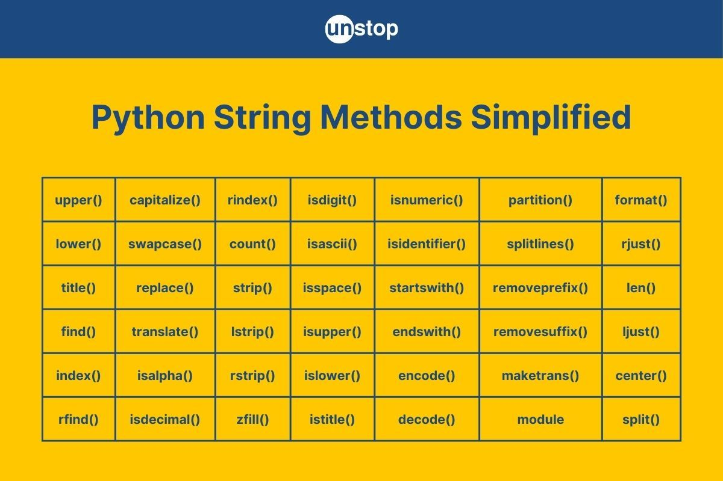

Slide 14
5. String Formatting
Modern Python applications primarily utilize Formatted String Literals (f-strings) for cleaner variable injections.
name = "Alice"
age = 30
# Modern f-string approach
print(f"Name: {name}, Age: {age}") # Output: Name: Alice, Age: 30
# Legacy .format() method approach
print("Name: {}, Age: {}".format(name, age))

Slide 15
6. The str() Global Constructor Function
The built-in global function str(object, encoding, errors) transforms non-string objects (like integers, floats, lists, or dictionary keys) into their readable text representations.
num = 456
converted = str(num) # Converts integer 456 to string "456"
print(type(converted)) # Output: <class 'str'>

Slide 16
Level-0
Vowel and Consonant Counter: Write a program to count the total number of vowels and consonants in a given sentence while ignoring digits and spaces.
Character Extraction: Take an input string and generate a new string made exclusively of its first, middle, and last characters.
Case Toggler: Iterate through a string and convert all lowercase characters to uppercase, and vice versa.
Character Search: Given a string and a single target character, return the first index where the character appears, or -1 if it is not present.
Digit-Only Check: Write a boolean function that verifies if a given string contains only numerical digits.

Slide 17
Level-1
String Reversal (In-Place): Reverse the sequence of characters in a string without utilizing an additional array or temporary string variable.
Word Reverser: Reverse the order of words in a sentence while keeping the characters within the individual words in their original order.
First Non-Repeating Character: Scan a string and find the very first character that does not repeat anywhere else in the sequence.
Anagram Validator: Take two strings and determine if they are anagrams of each other (meaning they contain identical character counts in a different order).
Palindrome Checker: Check if a string reads the exact same forward and backward, ignoring case differences and punctuation.
Character Frequency Map: Create a function that tallies and prints the occurrence count of every distinct alphabet character inside a string.

Slide 18
Level-2 (Advance)
Based on: Dynamic programming, pattern matching, and complex parsing constraints.
Longest Unique Substring: Find the length of the longest continuous substring that contains no repeating characters.
String Rotation Check: Given two strings, write a program to verify if one string is a valid rotation of the other (e.g., "clear" and "earcl").
Valid Parentheses: Use a stack tracking mechanism to confirm if a string containing brackets ((), [], {}) opens and closes in the correct, balanced order.
Run-Length Encoding (RLE): Implement a basic data compression algorithm that converts a string like "AAABBC" into its compressed structural summary, "A3B2C1".
String-to-Integer (atoi): Manually implement the conversion of a numeric text string into an actual integer variable, managing edge cases like negative signs, leading whitespaces, and overflow errors.

